Slide 1
Conceptual View of Memory Cell

Slide 2
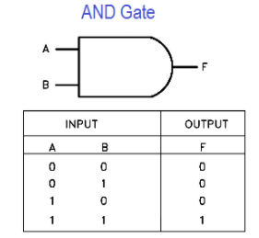
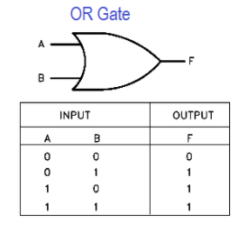
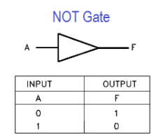
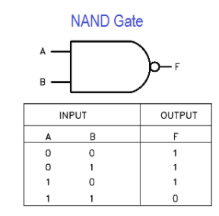
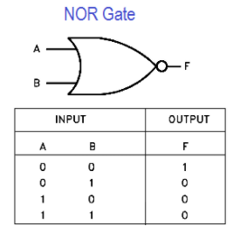
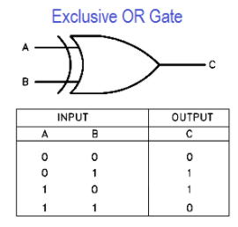
Recap: Truth tables of Logic gates
Truth tables of logic gates

Slide 3
Conceptual View of Memory Cell
Truth tables of logic gates
circuitry of memory cell

Slide 4
Function of Memory Cell
Truth tables of logic gates
circuitry of memory cell
Function of Memory Cell
1
Select
1
1
1
0
1
0
Data in
0
D
0
1
Data out
1
0
1
1
1
R / W
0

Slide 5
Function of Memory Cell
Truth tables of logic gates
circuitry of memory cell
Function of Memory Cell
1
Select
1
1
1
0
1
0
Data in
0
D
0
1
Data out
1
0
1
1
1
R / W
0

Slide 6
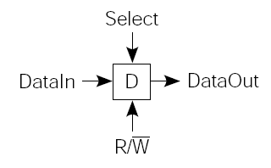
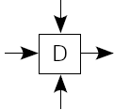

Memory Organization
Truth tables of logic gates
circuitry of memory cell
Function of Memory Cell
Memory Organization
Select

Slide 7
Memory Organization
Truth tables of logic gates
circuitry of memory cell
Function of Memory Cell
Memory Organization
Select

Slide 8
De multiplexer
2 x 4
Select
Truth tables of logic gates
circuitry of memory cell
Function of Memory Cell
Memory Organization
Address Lines
Select
Select
Select
Data Lines

Slide 9
De multiplexer
2 x 4
Select
Truth tables of logic gates
circuitry of memory cell
Function of Memory Cell
Memory Organization,
Chip layout
CHIP
Address Lines
Select
Select
Select
Data Lines

Slide 10
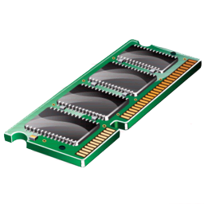
Typical Chip Layout
Truth tables of logic gates
circuitry of memory cell
Function of Memory Cell
Memory Organization
Chip layout
N X W
Memory Type
r/w
Data
Address
Ch. Select

Slide 11
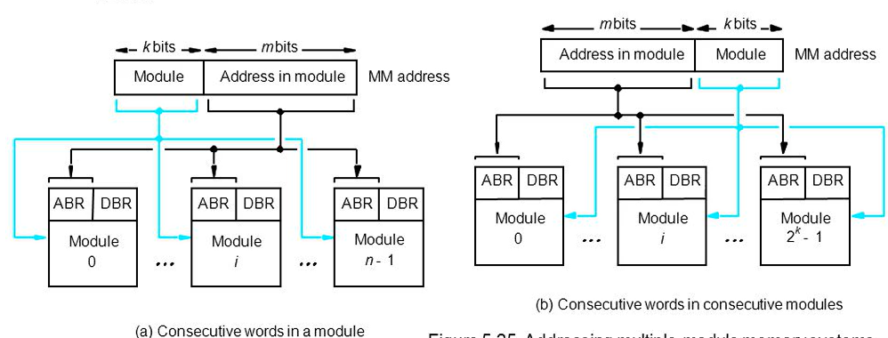
MEMORY INTERLEAVING
Memory Interleaving
If the Main Memory is structured as collection of physically separate modules.
Each with it’s own Address Buffer Register (ABR) and Data Buffer Register (DBR), memory access operations.
It may proceed in more than one module at the same time.
Hence, aggregate rate of transmission of words to and from the memory can be increased.

Slide 12
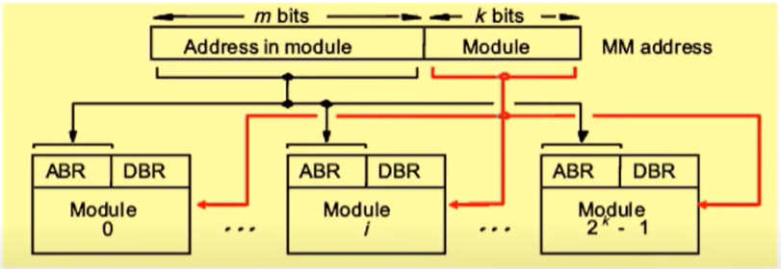
MEMORY INTERLEAVING
Memory Interleaving
Memory Interleaving is an abstraction technique.
Designed to compensate for core memory by spreading memory addresses evenly across memory banks.
Divides memory into a number of modules such that successive words in the address space are placed in the different module.
Parallel access is possible. Hence, faster.
Higher average utilization of the memory system.

Slide 13
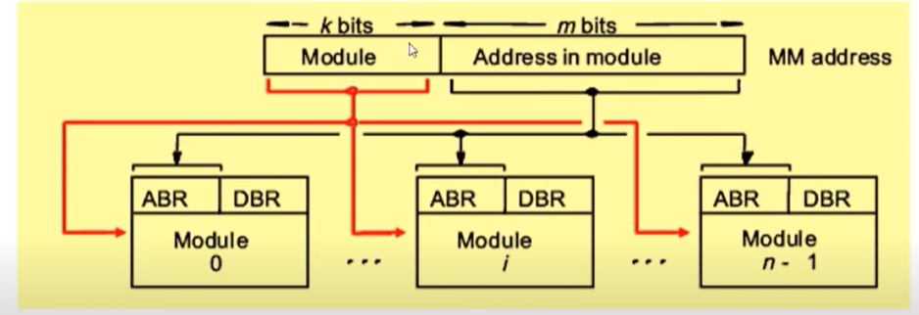
Distribution Methods in Memory system
Memory Interleaving
Distribution Methods in Memory system
Consecutive words in a module
When consecutive locations are accessed, as happens when a block of data is transferred to a cache, only one module is involved.

Slide 14
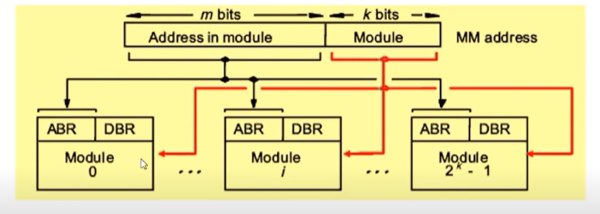
Distribution Methods in Memory system
Memory Interleaving
Distribution Methods in Memory system
Consecutive words in a Consecutive module
This method is called memory interleaving
Parallel access is possible. Hence, faster
Higher average utilization of the memory system

Slide 15
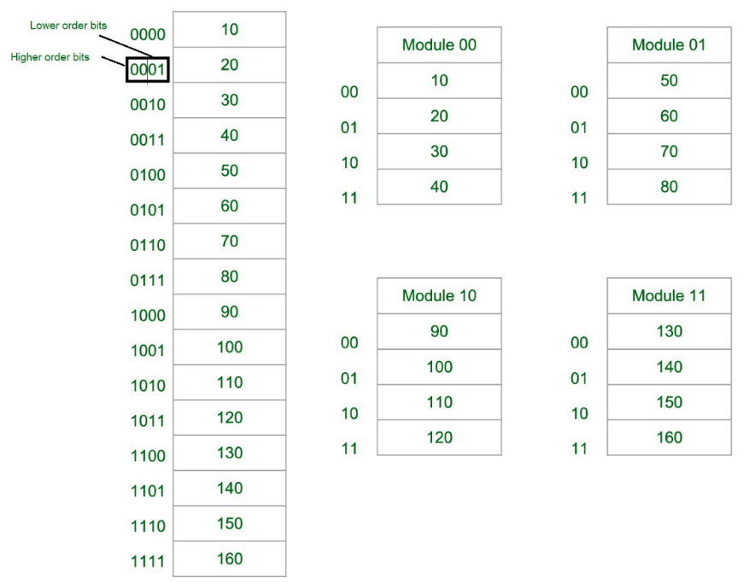
Distribution Methods in Memory system
Memory Interleaving
Distribution Methods in Memory system
Consecutive words in a module

Slide 16
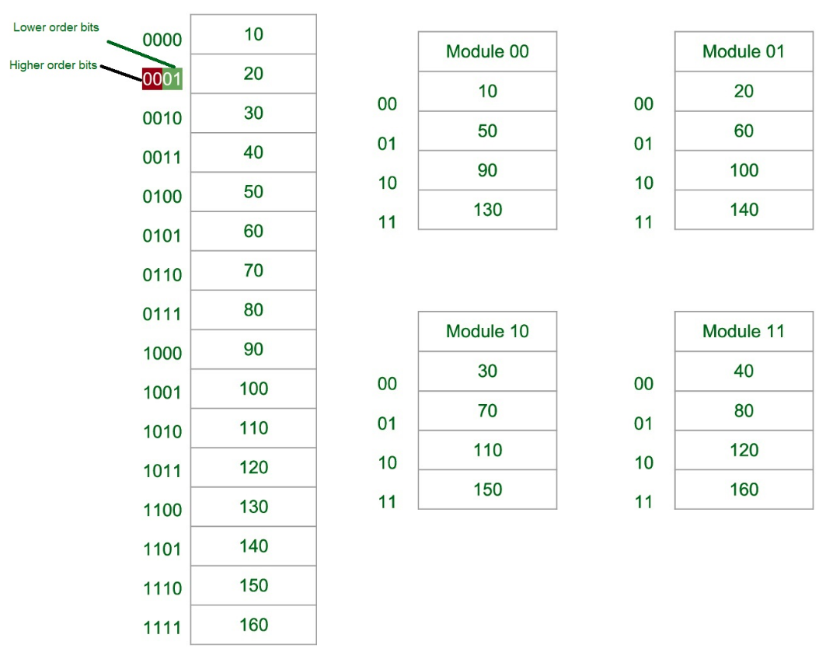
Distribution Methods in Memory system
Memory Interleaving
Distribution Methods in Memory system
Consecutive words in a Consecutive module:

Slide 17
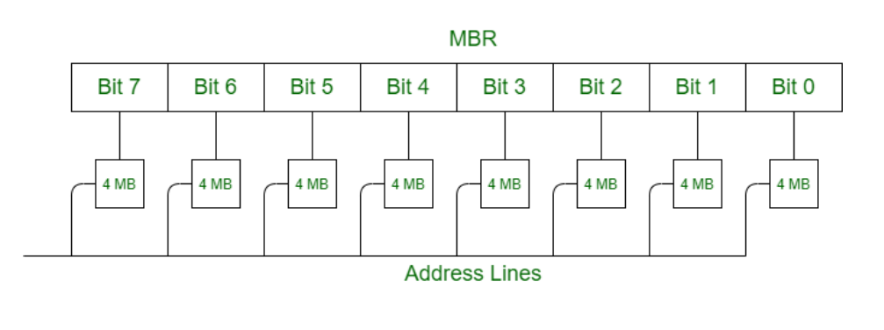
Usage of Memory Interleaving
Memory Interleaving
Distribution Methods in Memory system
Usage of Memory Interleaving
Main memory is relatively slower than the cache.
So to improve the access time of the main memory, interleaving is used.
This method uses memory effectively.

Slide 18
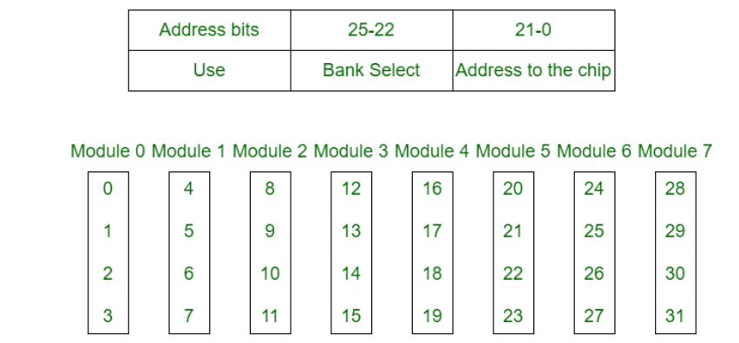
Classification of Memory Interleaving
Memory Interleaving
Distribution Methods in Memory system
Usage of Memory Interleaving
Classification of Interleaving
Memory interleaving is classified into two types:
Two address formats for Memory Interleaving.
High Order Interleaving –
In high-order interleaving, the most significant bits of the address select the memory chip.
The least significant bits are sent as addresses to each chip.
The maximum rate of data transfer is limited by the memory cycle time.

Slide 19
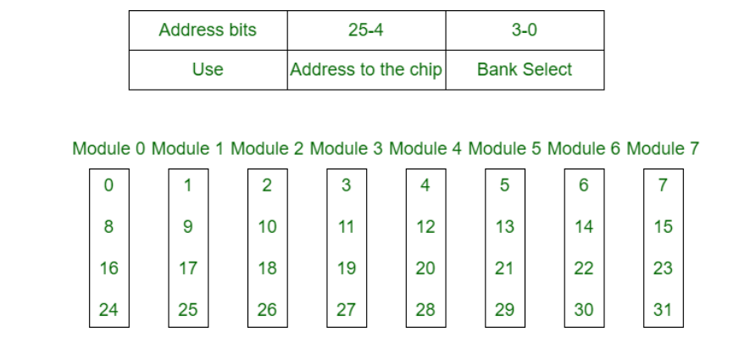
Classification of Memory Interleaving
Memory Interleaving
Distribution Methods in Memory system
Usage of Memory Interleaving
Classification of Interleaving
2. Low Order Interleaving –
In low-order interleaving, the least significant bits select the memory bank (module).
In this, consecutive memory addresses are in different memory modules.
This allows memory access at much faster rates than allowed by the cycle time.

Slide 20
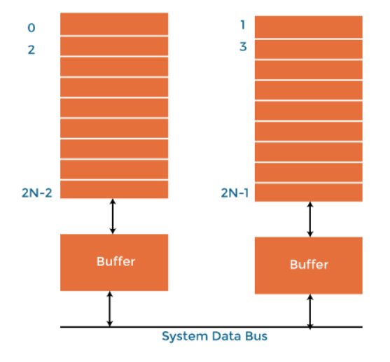
Benefits of Memory Interleaving
Memory Interleaving
Distribution Methods in Memory system
Usage of Memory Interleaving
Classification of Interleaving
Benefits of Memory Interleaving
It allows simultaneous access to different modules of memory.
Interleave memory is useful in the system with pipelining and vector processing.
In an interleaved memory, consecutive memory addresses are spread across different memory modules.
Reduce the memory access time by a factor close to the number of memory banks.

Slide 21
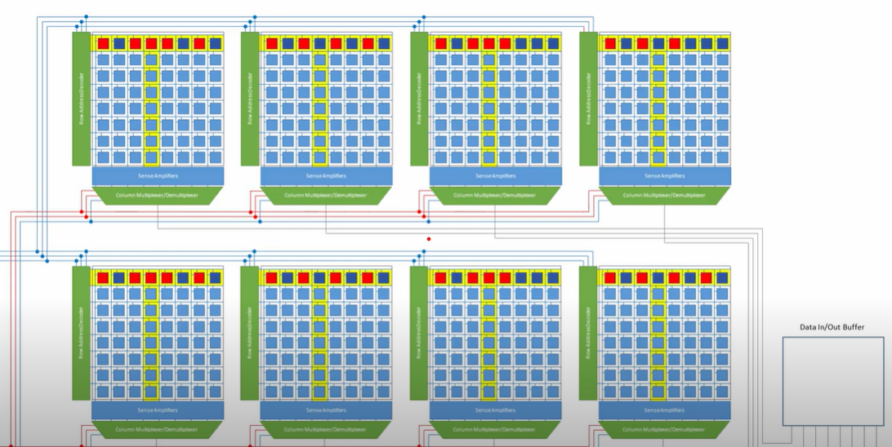
Interleaving DRAM
Memory Interleaving
Distribution Methods in Memory system
Usage of Memory Interleaving
Classification of Interleaving
Benefits of Memory Interleaving
Interleaving DRAM
Main memory is usually composed of a collection of DRAM (Dynamic random-access memory) memory chips grouped together to form a memory bank.
The memory banks will be interleaved.
Memory accesses to different banks can proceed in parallel with high throughput.
Memory banks can be allocated a contiguous block of memory addresses, gives an equal performance and access gives far better performance in interleaved layouts.

Slide 22
Comparison of Size, Cost/bit and Access Time for Memory Hierarchy
Memories importance, Memories organization
Memory Hierarchy: CPU registers, Cache Memory, Main memory, Auxiliary memory
CPU Registers → Ax.M: Size: Increases,
Access Time: Decreases, Cost/Bit: Decreases
Cost/bit
CPU Registers
Cache Memory
Main Memory
Auxiliary Memory
Size
Access Time

Slide 23
Problem
Consider a main memory system that consists of 8 memory modules attached to the system bus, which is one word wide. When a write request is made, the bus is occupied for 100 nanoseconds (ns) by the data, address, and control signals. During the same 100 ns, and for 500 ns thereafter, the addressed memory module executes one cycle accepting and storing the data. The (internal) operation of different memory modules may overlap in time, but only one request can be on the bus at any time. The maximum number of stores (of one word each) that can be initiated in 1 millisecond is?

Slide 24
Summary
Memory Interleaving
Consecutive words in a module
Consecutive words in consecutive module
Usage of Memory Interleaving
Main Memory
Cache
Classification of Memory Interleaving
High Order Interleaving
Low Order Interleaving
Benefits of Memory Interleaving
Interleaving DRAM
Examples

Slide 25
References
T1: W. Stallings, “Computer Organization and Architecture: Design for Performance”, 10th edition, PHI, 2016.
Chapter 5
T2: David A. Patterson and John L. Hennessy, “Computer Organization and Design: The Hardware/Software Interface”, 5th Edition, Morgan Kaufmann, Elsevier, 2011.
T3: Carl Hamacher, “Computer Organization and Embedded Systems”, 6th Edition, McGraw Hill Higher Education, 2011.
Web:
1.https://nptel.ac.in/courses/106/106/106106166/
2. https://nptel.ac.in/courses/106/105/106105163/

